Slide 1
Predicting right place to rent home in Toronto as per the preferences

Slide 2
INTRODUCTION:-
Audience/User - Sports enthusiast students looking for home to rent.
Business Problem - An athlete and sports enthusiast student is shifting from his home country to Toronto for higher studies so as result he/she is searching for home to rent near places where sports/fitness areas are located in close proximity. For this reason he has contacted a real estate agent to ease out his work. This project will recommend the areas to the real estate agent where he/she can allocate a home for rent to the student. This project will help the real estate agent in providing better quality of service by allocating proper homes for rent to its customer.

Slide 3
DATA:-
Toronto Postal Code and Neighborhood data will be used from the wiki page - https://en.wikipedia.org/wiki/List_of_postal_codes_of_Canada:_M .
Geo Coordinates will be used from the csv file provided - 'Geospatial_Coordinates.csv’.
Foursquare Data will be used to analyze different venues in the neighborhoods.

Slide 4
METHODOLOGY:-
Python Libraries Used:
Pandas and Numpy for Data Analysis
Wikipedia for extracting data from Wikipedia Page
Geopy to extract Geo Coordinates from an address
Sklearn to use K-Means Clustering
Matplotlib and Folium for Data Visualization

Slide 5
Data Collection
Toronto Poatal Code and Neighborhood data are collected from the above mentioned wiki page with help of 'wikipedia' library.
'Geospatial_Coordinates.csv' is imported and merged with the Neighborhood data for further processing.
Foursquare Data is collected with help of API.

Slide 6
Data Wrangling and Exploratory Analysis
Neighborhood data is wrangled by removing unassigned values to Borough and by renaming the columns
Geospatial coordinates data is then merged to the Neighborhood data to generate the final dataframe

Slide 7
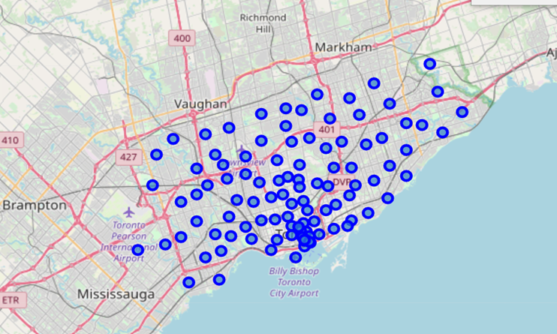
Toronto Neighborhoods look like below:-

Slide 8
3. A function is written to call the Foursquare API and get top 100 venues in the neighborhoods in Toronto.
4. Each Neighborhood is analyzed by one hot encoding to produce frequency of occurence of different venues in each neighborhood
5. The data is grouped by Neighborhood and filtered with only below venue categories: Park, Gym, Gym/Fitness Centers, Sporting Goods Shop, Yoga Studio, Playground, Trail, Baseball Field, Athletics & Sports, Pool, Basketball Stadium, Hockey Arena, Baseball Stadium, Skate Park, Soccer Field and Stadium.

Slide 9
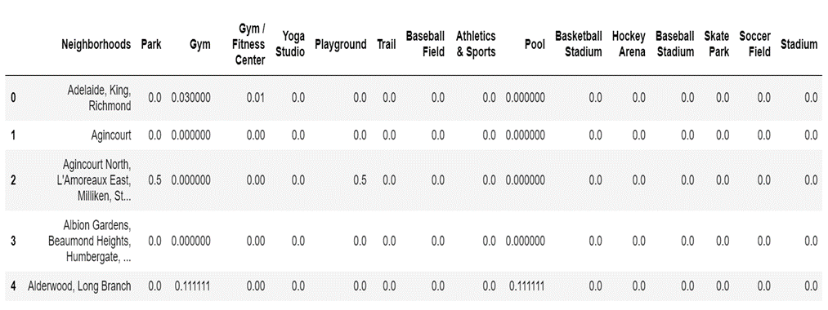
The data looks like below:-

Slide 10
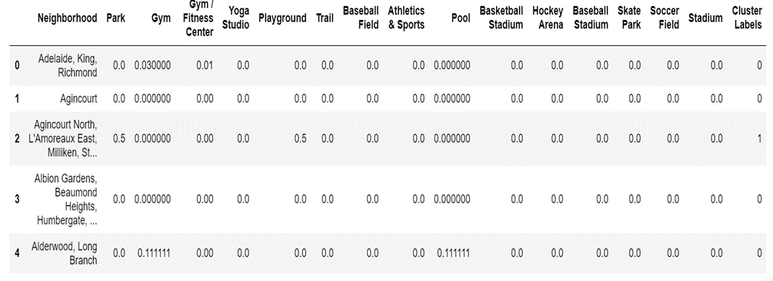
K-means Clustering:-
A K-Means clustering with 3 clusters have been performed.
Cluster labels are added to the dataframe.
Here is the data look like-

Slide 11
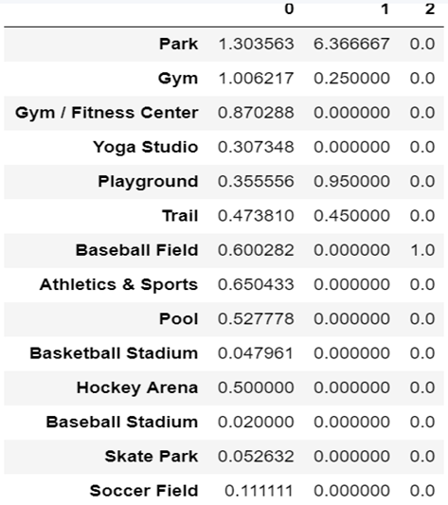
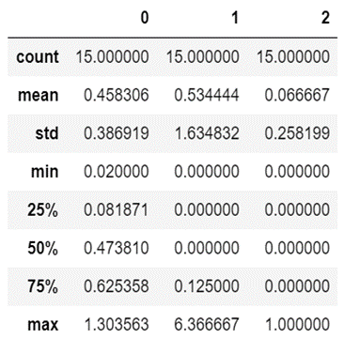
Below are the sum of occurances of each sporting venue in each cluster and statistics of the clusters:-

Slide 12
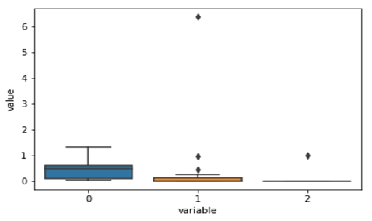
Data Visualization:-
The below box plot chart shows that wide variation and frequency of Sporting Venues are present in Cluster 0.

Slide 13
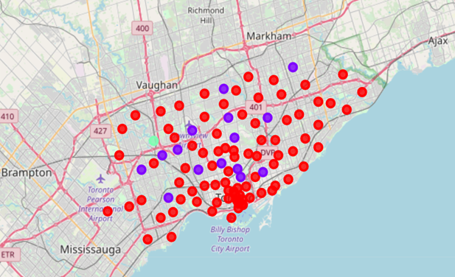
The Neighborhood clusters in the map of Toronto has been plotted with help of matplotlib and folium.
Red dots belong to cluster 0.
Blue dots belong to cluster 1.
Green dots belong to cluster 2.

Slide 14
Recommendation and conclusion:-
As per our initial assumption, the real estate agent would like to recommend an area where there are Sporting related venues in close proximity. As per our analysis, Cluster 0 could be recommended. However, there are several neighborhoods in cluster 0. Inorder to recommend top 5 neighborhoods, below steps are performed.
The dataframe was sorted based on maximum types and maximum count of venues
The top 5 Neighborhoods are recommended to open the store
Business Reply Mail Processing Centre 969 Eastern (Cluster 0)
Rosedale (Cluster 1)
Moore Park, Summerhill East (Cluster 1)
Thorncliffe Park (Cluster 0)
Queen's Park (Cluster 0)

Slide 15
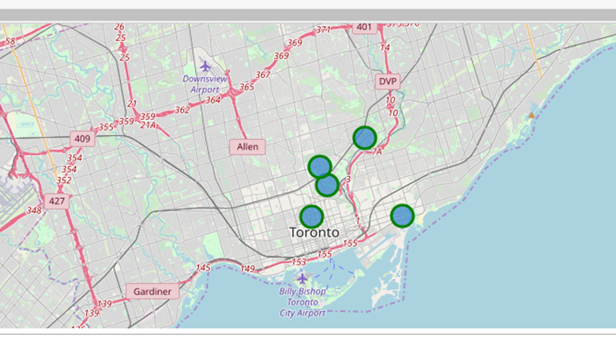
The top 5 recommended neighborhoods look like this:

Slide 16
Thank you

